Slide 1

Create software any platform without coding.
Why code when you can draw?

Slide 2
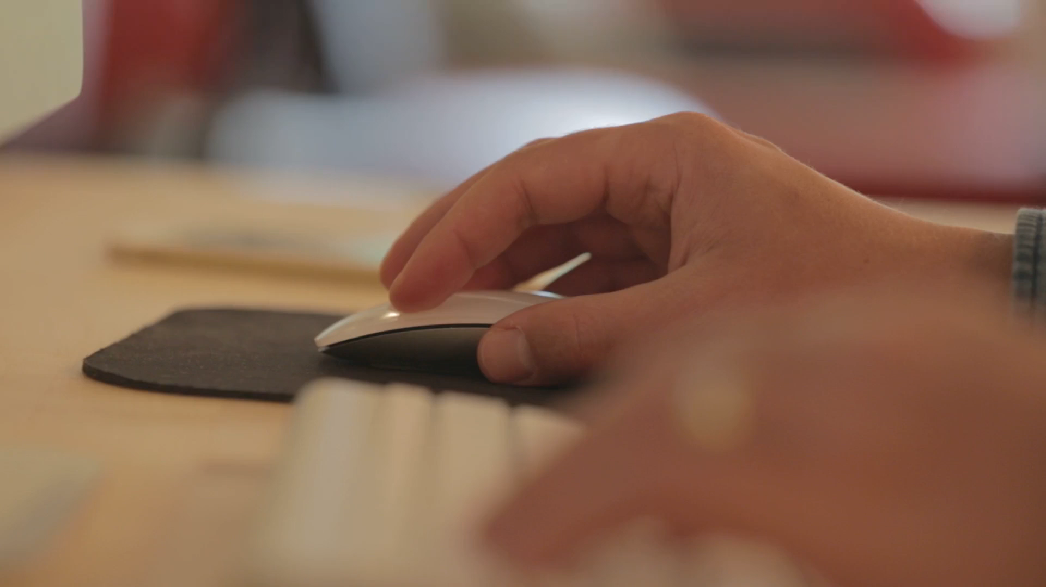

Slide 3


Code by drawing
No real code needed.
Create anything, on any platform
OUR AGENDA
Build entirely new systems, or modify existing software with new building blocks.
Integrate
With Zero Code, you can change virtually any existing system.
Flexible and intuitive
Create anything from views to data structures without needing to write any actual code.

Slide 4
BUSINESS MODEL
PARTNERSHIPS
MARKETPLACE
Cuts of partner profits
Holding shares of partner companies
%-based cuts of all sales made in our marketplace
A
B
Our tool itself is free. We make money when our partners and users make money.

Slide 5
CURRENT SITUATION
First customers secured
Multiple future partners have already expressed interest on working on new products using Zero Code.
Tool is 90% finished
Over 5 years of coding done. Tools are completely functional and only lack visual elements.
Lots of building blocks to offer our partners and users
We have numerous existing ERP system modules like billing or timecard modules for our customers to start building on and selling.

Slide 6
TEAM
Pasi Mankinen, CTO, Founder
Arto Kokkila, Programmer
João Grossi, Startup Partner
Olli Rundgren, Startup Advisor
Markus Mäntynen, Startup Advisor
Harri Paananen, Business Metrics
Jari Lehtinen, Sales Advisor
Jukka Raimovara, Server Tech
Kimmo Kulmala, Marketing Advisor
Mikko Vainikainen, Sales
Simo Kyllönen, Sales
Kai-Kristian Kemell, Sales Planning, PR
Michael Kinuthia, Business Planning
Jaakko Palvaila, Presentation Tech

Slide 7
Help us take our business further
Contact (CEO): Pasi Mankinen
pasi.mankinen@manageapp.com
Create software any platform without coding.
Why code when you can draw?

