Slide 1

DO YOU FEEL DAUNTED?
Easy Business

Slide 2

The Problem
The Problem
Using business software (ERP) is stressful
Hard to use, do not even work when needed
It does not deliver necessary information
People get frustrated and don't fill data in to system ERP is merely a mechanical software like a Typewriter, it does not provide real metrics

Slide 3
The Problem
The Problem
Using business software (ERP) is stressful
Hard to use, do not even work when needed
It does not deliver necessary information
People get frustrated and don't fill data in to system ERP is merely a mechanical software like a Typewriter, it does not provide real metrics
nonsense data in, nonsense data out

Slide 4
problem validation
The Problem
We have been in ERP software business for 31 years
The customer need has been validated by current customers as few million euros were spent in to our ERP product during time period above mentioned

Slide 5
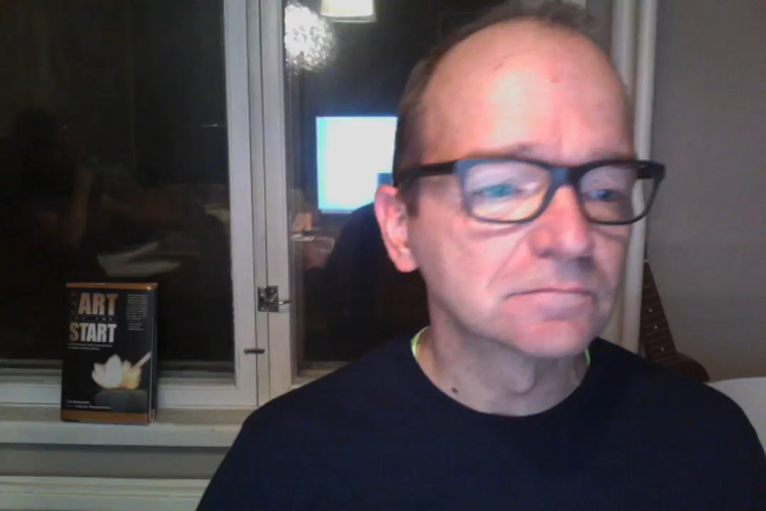
The Problem
The Problem
Harri Paananen
controller, MA
"typical user"
Olli Rundgren
CEO, Psyon Games
"management need"

Slide 6

The solution
The Problem
Our web based software
faster and easier to use
Lots of unique features
Handles enterprise -level demands

Slide 7
Value to customer vs unique product
Feet to the ground
Unique
price
value to customer

Slide 8



Value to customer vs unique product
Feet to the ground
Unique
SIZE OF THE MARKET
price
required by law
value to customer

Slide 9
Value to customer vs unique product
Feet to the ground
Unique
SIZE OF THE MARKET
invoicing
price
required by law
value to customer

Slide 10
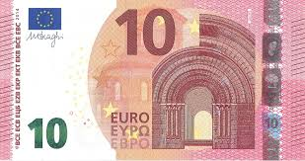
Value to customer vs unique product
Feet to the ground
Unique
SIZE OF THE MARKET
invoicing
10€ / month / user
price
required by law
value to customer

Slide 11
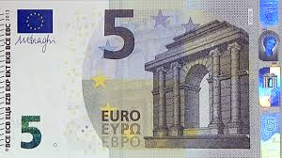
Value to customer vs unique product
Feet to the ground
Unique
documents management system
timecard, travel bills
SIZE OF THE MARKET
invoicing
price
required by law
value to customer

Slide 12
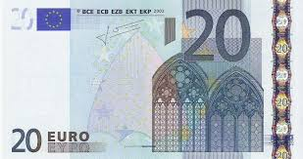
Value to customer vs unique product
Feet to the ground
Unique
inventory control, wip
bill of materials
documents management system
timecard, travel bills
SIZE OF THE MARKET
invoicing
price
required by law
value to customer

Slide 13
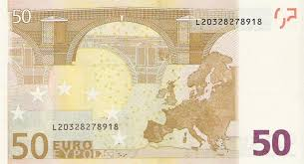
Value to customer vs unique product
Feet to the ground
master production schedule
manufacturing resource planning
Unique
inventory control, wip
bill of materials
documents management system
timecard, travel bills
SIZE OF THE MARKET
invoicing
price
required by law
value to customer

Slide 14
Value to customer vs unique product
Feet to the ground
Local support, reseller
master production schedule
manufacturing resource planning
Unique
inventory control, wip
bill of materials
documents management system
timecard, travel bills
SIZE OF THE MARKET
invoicing
price
required by law
value to customer

Slide 15
unique features
The Problem
Users can create their own content
translations, forms, reports, graphs
create new databases
add-ons
sell added-value content in marketplace

Slide 16

head to the clouds
future plans
Business platform
marketplace like App Store / Steam
customers can earn more than they pay
worldwide reseller network

Slide 17


head to the clouds
future plans

Slide 18


head to the clouds
future plans

Slide 19


head to the clouds
future plans
Nova
Our software on top of existing ERP systems.

Slide 20
market size
future plans
283 290 companies in Finland
ERP Software Market is Expected to Reach $ 41.69 Billion, Globally by 2020
SaaS ERP grows 16% yearly
Start in countries with relatively low competitors such as Estonia and Poland

Slide 21
Team
Current situation
1. Entrepreneur, CTO: Pasi Mankinen
2. Customer support, programmer: Arto Kokkila
3. Server technology: Jukka Raimovara
4. Business metrics: Harri Paananen
5. Startup: João Grossi, Brasilia, Brasil
6. Sales advisor: Jari Lehtinen, Sales Manager, Outokumpu PSC Finland Oy (investor)
7. Marketing advisor: Kimmo Kulmala, M. Sc, Lecturer (digital marketing) at JAMK
8. Startup advisor: Olli Rundgren, CEO of Psyon Games
9. Startup advisor: Markus Mäntynen, CEO at Kasvu.io Growth Venture Oy
10. Sales: Mikko Vainikainen, VA-Varuste Oy
11. Sales: Simo Kyllönen, serial entrepeneur

Slide 22
Investment 'ask'
future
Execution power
"been there, done that" -knowledge
money to execute €

Slide 23
Investment 'ask'
future
Execution power
"been there, done that" -knowledge
money to execute €
Project managers
design team, user experience (UX) specialists
frontend developers: VueJs, ECharts, InteractJS

Slide 24
Investment 'ask'
future
Execution power
"been there, done that" -knowledge
money to execute €
Project managers
design team, user experience (UX) specialists
frontend developers: VueJs, ECharts, InteractJS
Marketing team, resellers

Slide 25

THANK YOU

Slide 26
Feedback 1
feedback
sleep more
make sure that no-one touches your machine and sound setup when it has been tested
show all the slides, not 60% of them
show market size early in the presentation
make more clear how to differentiate from other products
show real product?
make notes of the feedback, Markus Mäntynen promised to send his notes in email
find out customer acquisition cost
ask for the money, how much?
is it ok say we are doing Tekes application?
I pay 30 000€ / Tekes gives 50 000€
I have too much to tell
should I focus only on some part?
which part?
some professional to do the presentation
milestones, assumptions, tasks

Slide 27
Feedback 2
feedback
find the name for a company
compare 2 options

